Slide 1
STA using Prime Time
Date : 01 July 2024

Slide 2
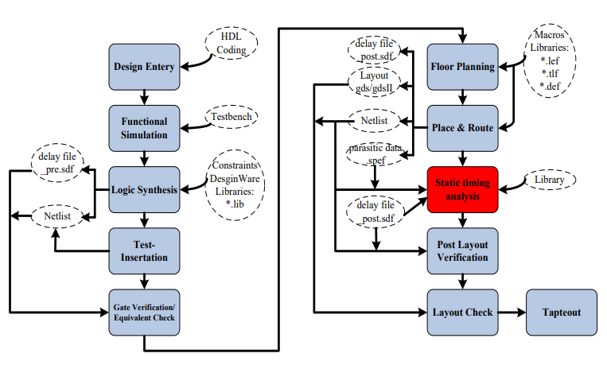
What’s STA
STA is a method of validating the timing performance of a design by checking all possible paths for timing violations.

Slide 3
PrimeTime - Overview
• PrimeTime is the Synopsys stand-alone full chip, gate-level static timing analyzer
• Widely-adopted in industry and academia, sign-off tools
• Controlled by Tool command language (TCL) compatible with DC

Slide 4
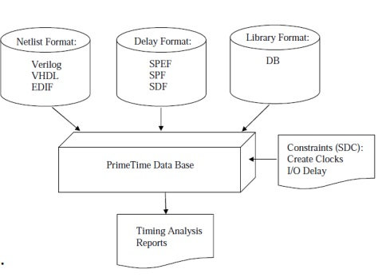
PrimeTime - Input/Output
Inputs:
– Netlist file
• Verilog/VHDL/EDIF
– Delay format:
• SPEF/SPF/SDF
– Database file (DB):
• Determine the cell delay
– SDC file:
• Define the design to PT
Outputs: – Timing Analysis Reports

Slide 5
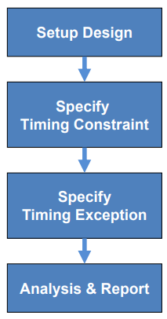
PrimeTime - STA Flow

Slide 6
PrimeTime - Setup Design
• Set the search path and the link path
set search_path “lib path”
set link_library “* design.db”
set target_library “design.db”
• Read the design and the libraries
read_verilog top_level.v current_design “top_level“
• Link the top design
link_design

Slide 7
PrimeTime - Timing Constraint
• Clock Period Constraint (script)
create_clock -period 2 [get_ports clk_in]
# define a clock with a frequency of 500 MHz or 2ns period in PrimeTime
set_clock_uncertainty # [get_clocks clk_in]
# define delay between the clock branches (skew).
For pre-layout
set_propagated_clock [all_clocks]
# specifies that PrimeTime realized the latency for each clock path. This command should be used during post route analysis.
read_sdc top_level.sdc

Slide 8
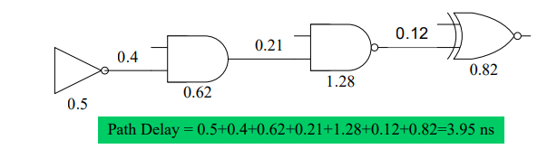
PrimeTime - Timing Constraint
• Input Delay – Specify the delay of external logic driving current design
set_input_delay -clock clk_in -max #[get_ports i_*]
• Output Delay – Specify the delay of external logic driven by current design
set_output_delay -clock clk_in -max #[get_ports O_*]
• path delay = cell delay + net delay

Slide 9
PrimeTime - Path Delay Calculation
– Cell delay is stored in files called Synopsys database files or db files. Database files are read into PrimeTime by the link_path variable
– Net delay is stored in sdf file (post-layout) or calculated by PrimeTime by an internal delay calculator (pre-layout).
set link_library “*.db”
read_parasitics -format SPEF top_level.spef.gz (Required after post lay out)
read_sdf top_level.sdf

Slide 10
PrimeTime - Working Condition
– Use the worst case delay when testing for setup violations
– Use the best case delay when testing for hold violations
set_operating_conditions
Operating condition is defined in library

Slide 11
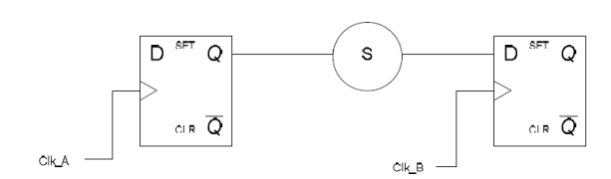
PrimeTime - Timing Exception
• False Path – paths in a design were a designer would not want the timing arcs to be calculated
• Paths not relevant to functional operation of the circuit
• paths which are impossible to exercise
• Paths cross different clock domains
set_false_path –from clk_a –to clk_b
set_false_path –from clk_b –to clk_a

Slide 12
PrimeTime - Generating Reports
To reduce the size and complexity of the PrimeTime reports, it is recommended to break the design into groups.
Report Timing :
report_timing
Report Violation :
report_constraints
Report Clock Timing :
report_clock_timing
Report QOR :
report_qor

Slide 13
To start PrimeTime
Working with Prime Time
1. In GUI
pt_shell -gui
2. In Terminal (pt_shell)
working in pt_shell>
3. In terminal using script
working in pt_shell>
instead of using command we use script to run design and report

Slide 14
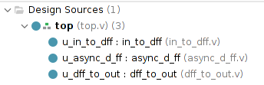
Prime Time Lab

Slide 15
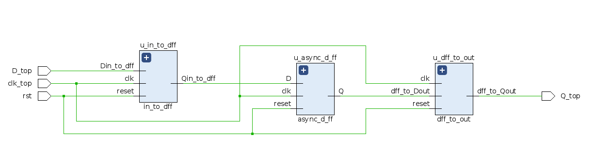
Prime Time Lab

Slide 16
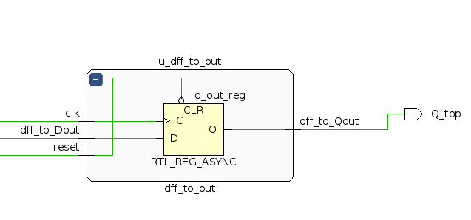
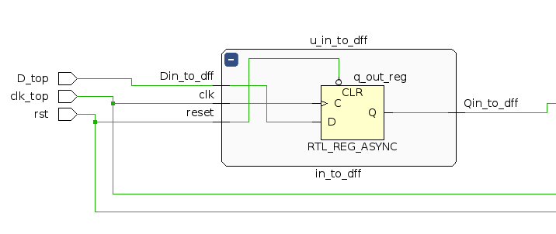
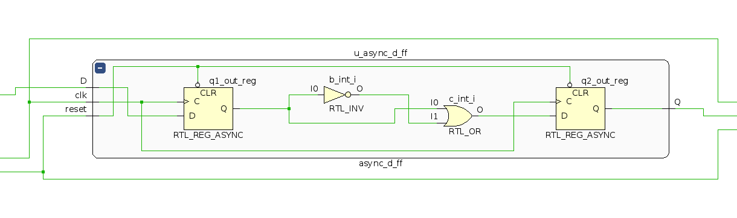
Prime Time Lab

Slide 17
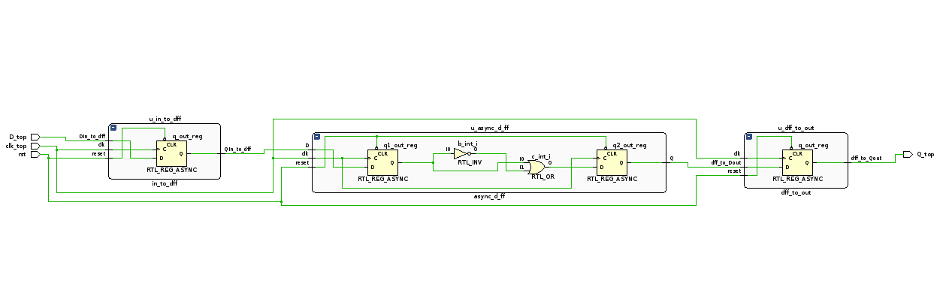
Prime Time Lab

